Slide 1
Citybikes API deployed on Heroku cloud
https://jspmvc.herokuapp.com/citybikes/CitybikesHome
The above JSP page link displays the list of all citybike networks across the world. Purpose of these slides are to elaborate on the Citybikes API implemented with the help of:
Spring Model View Controller
Rest Controller
RESTful Endpoint: http://api.citybik.es/v2/networks
Gherkin Features File
Cucumber JUnits

Slide 2
Citybikes API was implemented with the help of the following 15 files.
src/main/java/citybikesapis/Controller (2 files)
CitybikesController.java: Spring MVC controller class to invoke Rest Controller and render JSP
CitybikesRestController.java: RestController to consume the endpoint with help of JSon & DataMapper
src/main/java/citybikesapis/Model (5 files)
4 model/ entity classes with getter and setter methods to consume the JSON endpoint.
License.java
Location.java
Network.java
Root.java
Citybikeshome.java to return the list of all networks for being rendered on the JSP page
BDD features file (2 files): citybikes.feature and Frankfurt.feature
src/main/test/citybikesapitest (3 files): Cucumber Test runner runTest.java and CitybikesTest.java and CitybikesFrankfurtTest.java
Webcontent/WEB-INF/jsp (1 file): CitybikesHome.jsp to render the list of all the citybike networks across the world.
POM.xml (1 file): Build file to build the project with the help of maven and depoy on to Heroku cloud with the help of Heroku Maven plugin.

Slide 3
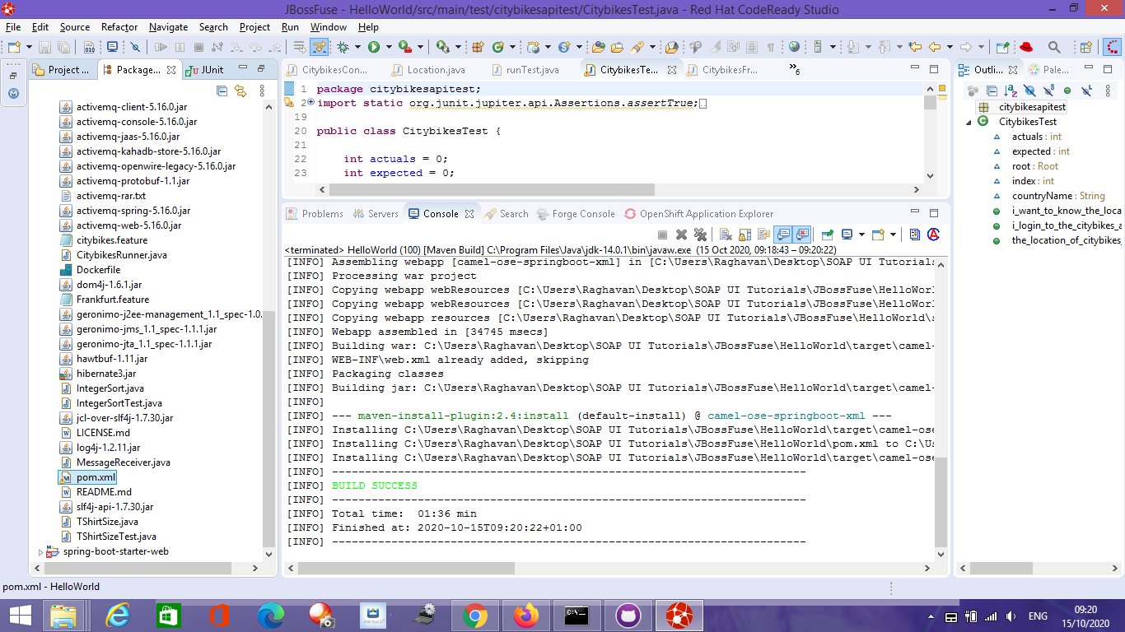
A slide to display successful build

Slide 4
Gherkin BDD features files
citybikes.feature
Scenario: 1)As a biker I want to know the location of citybikes across the globe
Given I want to know the location of citybikes across the world
When I login to the citybikes application
Then The location of citybikes across the world is displayed to me
Frankfurt.feature
Scenario: 2)As a user I want to verify that the city Frankfurt is in Germany and return their corresponded latitude and longitude
Given I'm a Biker
When I login into the Citybikes application to verify that the city Frankfurt is in Germany
Then I'm displayed that the city of Frankfurt is in Germany alongside the corresponding latitude and longitude

Slide 5
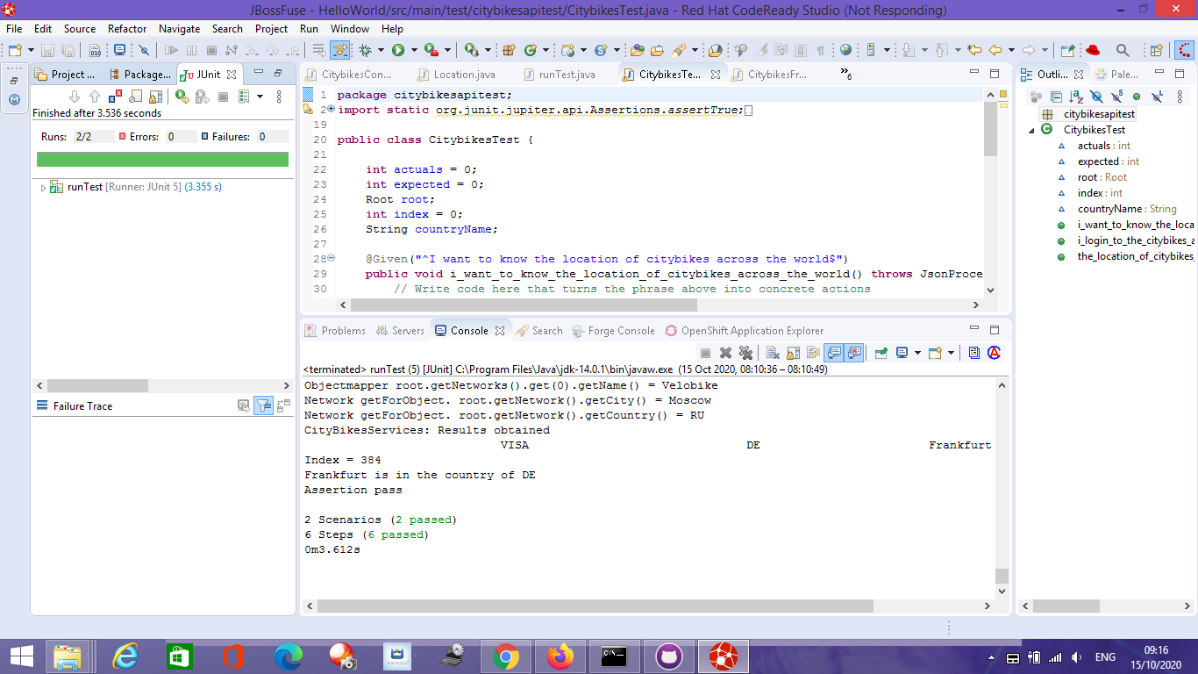
Cucumber JUnit

